Slide 1
“Intelligent Energy Consumption Analytics for Smart Buildings.”
Fundamentals of Data Engineering-24DEA3101
BACH-17
TEAM MEMBERS:
2420030235-CH.SHRAVANYA
2420090031-K.CHARANYA
2420030116-M.SWETHA

Slide 2
Comparison of Conventional Energy Monitoring vs Intelligent Analytics
Parameter | Conventional Energy Monitoring | Intelligent Energy Consumption Analytics (Proposed)
Data Generation | Energy data collected periodically from meters and logs. | Continuous data collection from IoT sensors and smart devices.
Data Ingestion | Manual or scheduled imports into spreadsheets/databases. | Automated ingestion using Python scripts and APIs.
Processing Model | Batch analysis after data collection. | Real‑time or near‑real‑time analytics using ML models.
Data Validation | Basic validation during manual entry. | Automated validation and anomaly detection using IQR method.
Data Transformation | Limited aggregation and normalization. | Dynamic feature engineering (temperature, humidity, time, appliance usage).
Temporal Processing | Time‑based trends analyzed post‑collection. | Hour, day, month, and seasonal attributes derived during processing.
Consumption Analysis | Performed after aggregation. | Continuous monitoring with predictive insights.
Data Storage | Stored in local files or basic databases. | Structured storage in SQL/MySQL with visualization support.
Analytics | Reports generated periodically. | ML‑based predictive analytics with performance metrics (MAE, MSE, RMSE, R²).
Visualization | Static charts or reports. | Interactive dashboards using Power BI / Streamlit.
Architecture | Batch‑oriented and reactive. | Intelligent, integrated, and proactive analytics pipeline.
Data Flow | Collect → Store → Analyze → Report | Sense → Ingest → Process → Predict → Detect → Recommend → Visualize
Scalability | Limited to small datasets. | Scalable for large sensor networks and multiple buildings.
Primary Focus | Historical consumption tracking. | Predictive, anomaly‑aware, and recommendation‑driven energy optimization.

Slide 3
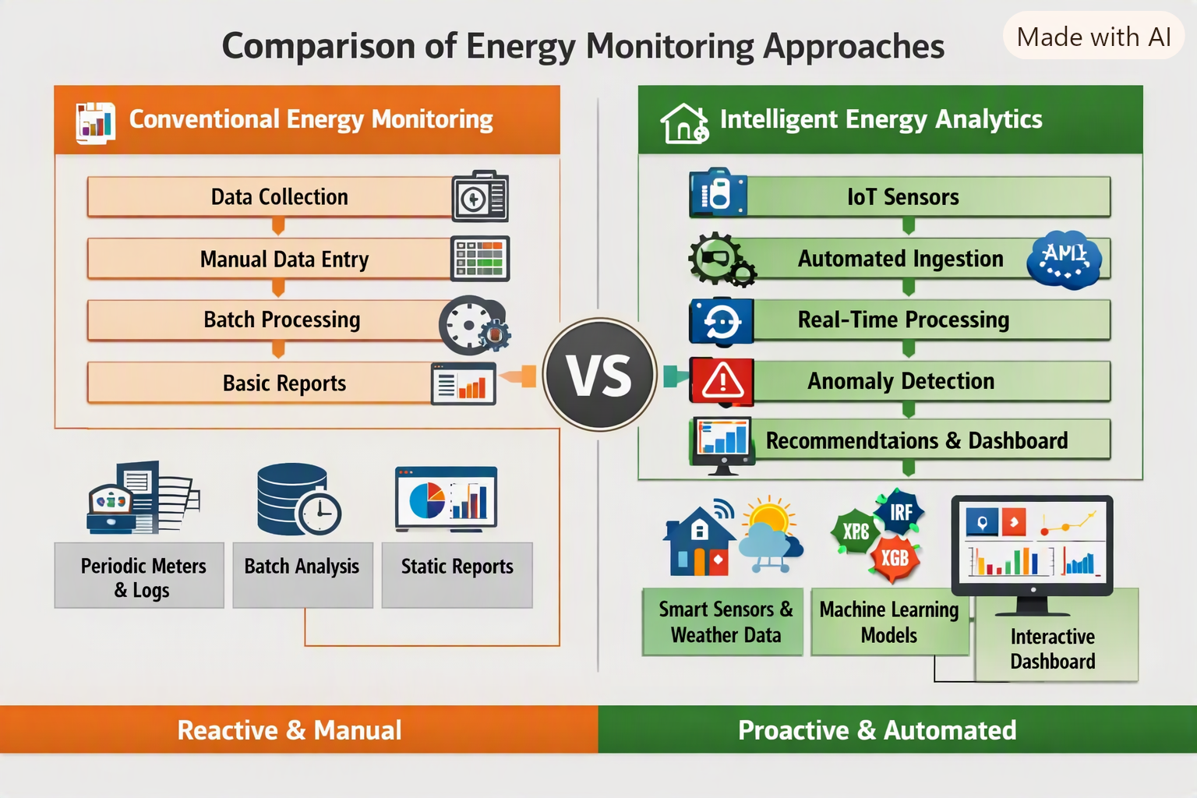

Slide 4
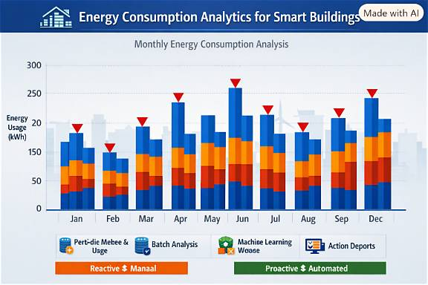

Slide 5


